Slide 1
Data Analytics on the Outdoor Project

Slide 2
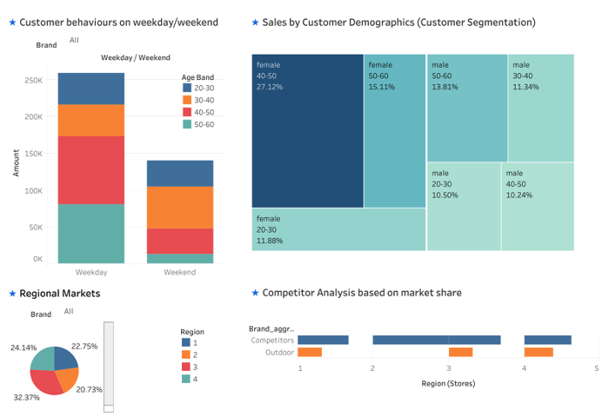
Younger Customers Engagement: Customers under the age of 40 exhibit lower purchasing activity during weekdays. To address this, Outdoor can enhance sales by implementing a targeted digital marketing strategy and offering exclusive discounts or rewards during off-peak times to this demographic.
Female Age Group 40-50: Females aged between 40-50 are a significant contributor to Outdoor's sales, indicating a strong affinity for Outdoor's products within this demographic. To capitalize on this, Outdoor can personalize marketing campaigns, curate product offerings, build a community, and implement loyalty programs specifically targeting this group.
Regional Market Expansion: While Outdoor holds a market share of between 31% and 38% in Regions 1, 3, and 4 where it operates stores, it lacks a physical presence in Region 2 where its competitors account for 20.73% of the market share. To tap into this unexplored market, Outdoor could expand its operations to Region 2, strengthen its online presence, and consider partnerships or pop-up stores.

Slide 3
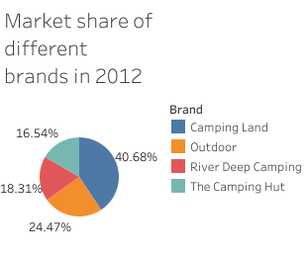
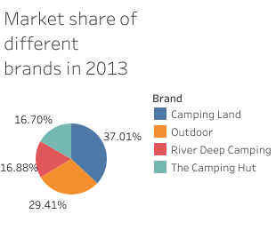
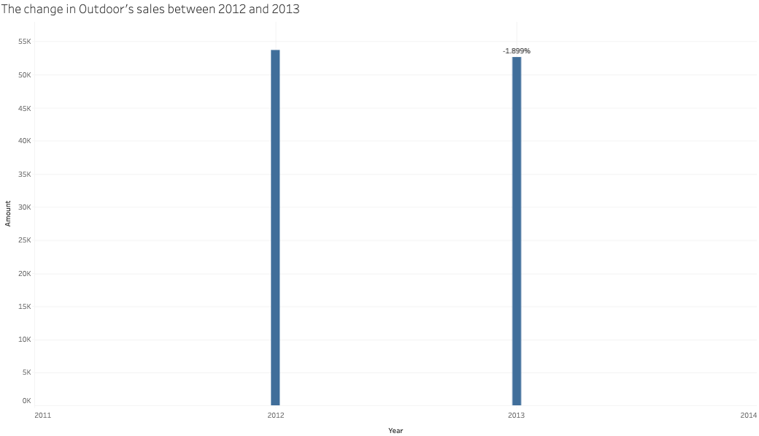
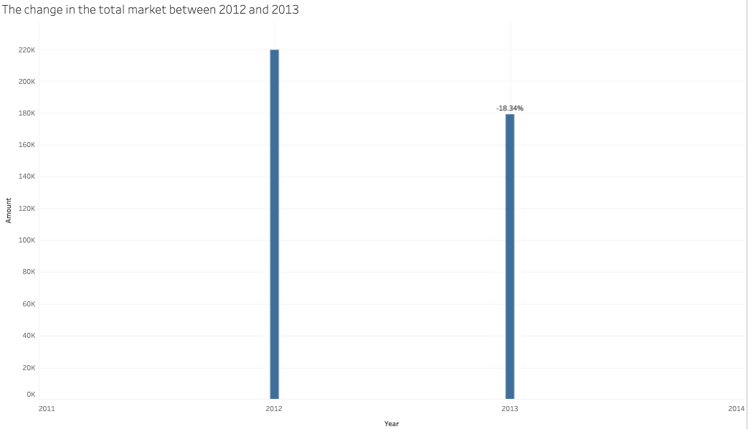
From 2012 to 2013, Outdoor’s sales decreased by 1.90%, while the total market shrank by 18.34%, possibly due to an economic recession. In terms of market share, Outdoor's share increased from 24.47% in 2012 to 29.41% in 2023 reflecting a 20.19% growth rate. During the same period, The Camping Hut's market share remained stable, River Deep Camping's share declined slightly from 18.31% to 16.88%, a decrease of 7.81%. Camping Land, the main competitor, saw its market share drop from 40.68% to 37.01%, at a rate of 9.02%.
A shrinking market means fewer total sales across the industry. Even with an increase in market share, Outdoor might be acquiring a larger piece of a progressively smaller pie. Thus, the growth in market share doesn't necessarily mean the company is growing fast in revenue.
Considering the shrinking market, it would be advisable for Outdoor to consider expanding operations in Region 2 only when the economy improves. (The prevailing economic conditions represent a substantial risk when considering the expansion of businesses.)

Slide 4
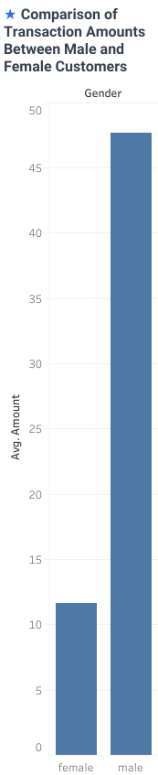
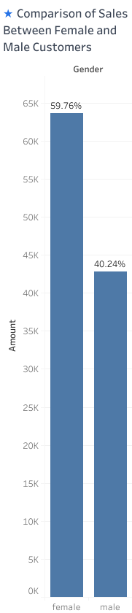
Comparison of transaction amounts between male and female customers: Male customers have a higher transaction amount but contribute less to Outdoor's total sales creating a unique opportunity to explore and address. Outdoor can develop targeted promotions, loyalty programs, or member benefits specifically designed to encourage repeat purchases from male customers.

Slide 5
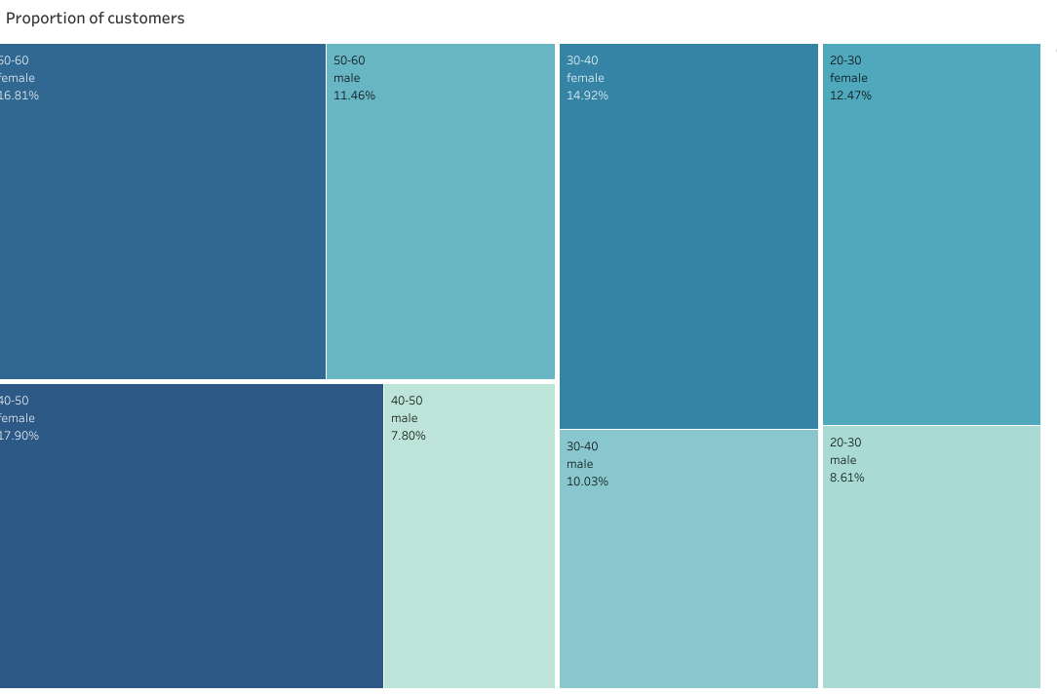
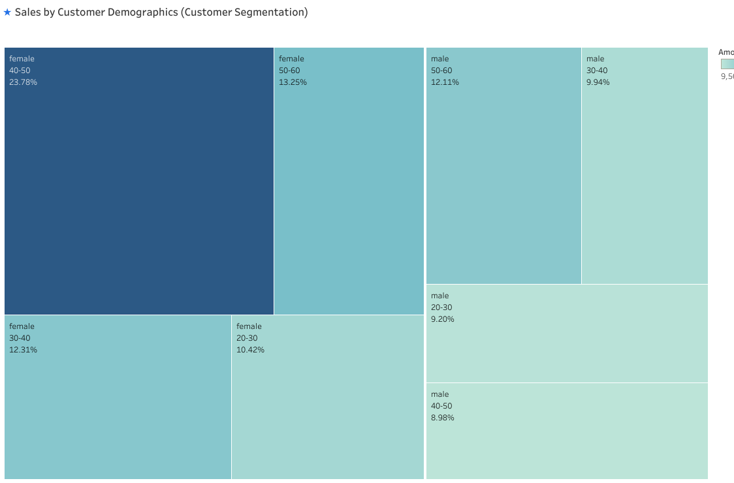
The proportion of different customer demographics: The distribution of various customer demographics corresponds with their respective contributions to the total sales.

Slide 6
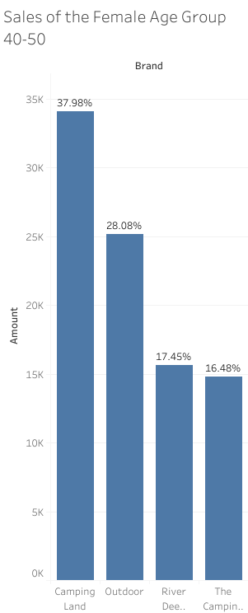
Sales of the Female Age Group 40-50: The female customer group aged 40-50 is a significant sales driver, and within this demographic, Outdoor holds the second-largest market share, while Camping Land has the largest share. Outdoor can explore the specific preferences and requirements of this particular customer group, identifying what attracts them to Camping Land. They can then evaluate whether they can create similar or superior offerings. By analyzing Camping Land's pricing strategies targeted at this demographic and engaging directly with these customers (collect feedback), Outdoor can gain insights into what they value and what could persuade them to switch from Camping Land to Outdoor.

Slide 7
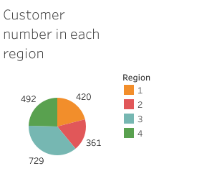
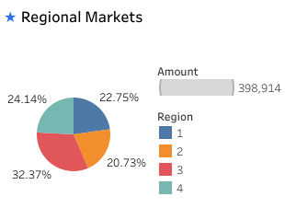
Customer number in each region: Region 3, with the highest number of customers and market shares, establishes itself as the largest market on this island. Outdoor could focus more on this region in future business expansion.

Slide 8

Thank you

